Slide 1
18CSE490T - Big Data Visualization
Unit 4 – D3 Tool
https://www.freecodecamp.org/news/d3js-tutorial-data-visualization-for-beginners/

Slide 2
Data Visualization?
Data visualization involves displaying information graphically (visually) to present a point or perspective on specific data. Beyond the simple graphs and charts in Excel, sourcing from aggregated transaction rows within a spreadsheet, today's businesses expect far more.
In this Unit, we will explore the process of visualizing data using a web browser and Data Driven Documents (D3) to present results from your big data analysis projects

Slide 3
Data Driven Documents or D3
D3 (or D3.js) is actually an open source JavaScript library (based upon its predecessor, the Protovis framework), designed with the intention of visualizing data using todays web standards.
D3 helps put life into your data utilizing Scalable Vector Graphics (SVG), Canvas, and standard HTML.
D3 combines powerful visualization and interaction techniques with a data-driven approach to DOM (Document Object Model) manipulation, giving you the full capabilities of modern browsers and the freedom to design the right visual interface for your data.

Slide 4
Data Driven Documents or D3
In contrast to many other libraries, D3.js allows inordinate control over the visualization of your data.
Its development was noted in 2011, as version 2.0.0 was released in August 2011
D3 is embedded within an HTML webpage, and uses prebuilt JavaScript functions to select elements, create SVG objects, style them, or add transitions, dynamic effects, and so on.
Detailed information, including the D3.js libraries can be accessed at https://D3js.org

Slide 5
D3 and big data
Easily bind or use your large datasets to common SVG objects using the functions available in the D3.js libraries
The data can even be in a variety of formats, most commonly JSON, comma-separated values (CSV), or geoJSON, but, if required, JavaScript functions can be written to read other data formats.
Can D3 really help in the context of big data?
Since it is low-level, D3 may seem like a bad fit for big data visualization projects. The D3.js libraries just won't work with gigabytes of data, but once you perform some preprocessing on the data, D3 can help make sense of the results.

Slide 6
D3 and big data
DataManager to address the quality of the data so it could be visualized) we used the following strategy:
Assembling the data
Profiling the data
Addressing quality concerns
Processing for visualization, that is, summarize or aggregate, and so on
Visualizing!

Slide 7
Getting Started with D3
The website may be found at
https://D3js.org
The latest version (at the time of writing) is V4.2.8, and that version can be downloaded from the following link:
https://github.com/D3/D3/releases/download/v4.2.8/D3.zip
You can simply link directly to the latest release libraries by inserting the following line in your projects:
<script src="https://D3js.org/D3.v4.min.js"></script>

Slide 8
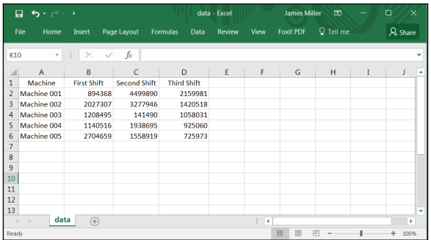
Working with D3 Sample
Dealing with manufacturing dataset (Data.csv)
The data logger is a program that gathers production-line data and writes it to a log file. In this scenario, the data logger is installed on each manufacturing machine. The data logger collects production data directly from the machine, stores it in memory, and periodically sends it off to the data repository (a log file).

Slide 9
Working with D3 Sample
Assuming you have already downloaded the D3 libraries, the steps to adopt the template and create our visualization are as follows:
Step-1. Download the grouped bar HTML template document.
Step-2. Open the document in any HTML editor (or any programmer's editor).
Step-3. Under the document's <body> tag, enter or modify the following code:
<body>
<! --- added a simple heading -->
<h1><center>Total Parts by Shift</cellspacing></h>
<! --- local include for D3 libraries -->
<script src="D3.v3.min.js"></script>
Step-4. What this modification does is to add text (Total Parts by Shift) to be used as our visualization's heading and changes the reference to the D3 libraries (the src= D3.v3.min.js) to be a local reference

Slide 10
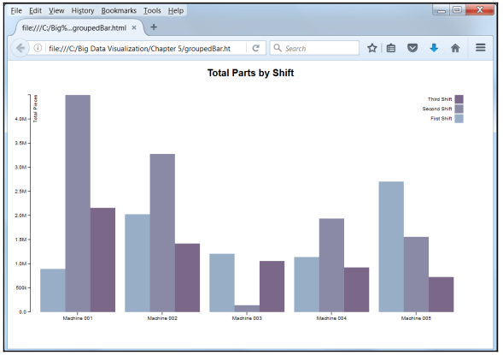
Working with D3 Sample (Con..)
5. Next, again assuming our data file is in the same local location as our HTML file, we can find the document's file reference (D3.csv) and verify the filename:
<!--- here is the data -->
D3.csv("data.csv", function(error, data) {
Once we've saved the updated HTML document, we can view it using any web browser. Voila! We've created our first big data visualization using D3:

Slide 11
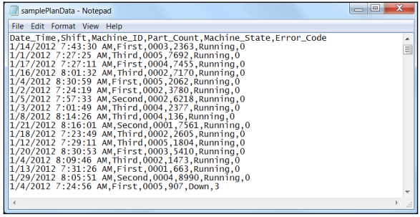
Digging deeper into the specifics of D3 use
Management wants to determine how the different shifts contribute to overall profitability or perhaps how each individual shift compares to the others.
There are several key performance indicators (KPIs) to be scrutinized. One such indicator is total parts delivered by shift.
shows a portion of our raw data:

Slide 12
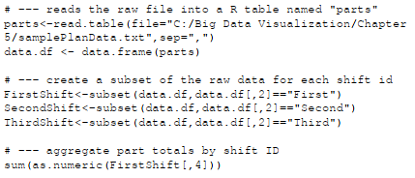
Digging deeper into the specifics of D3 use (Con..)
we've already worked with R in this book, we will use it again to manipulate our raw plant data.
The following is the simple R scripting used to aggregate the part counts by shift ID to a summary file

Slide 13
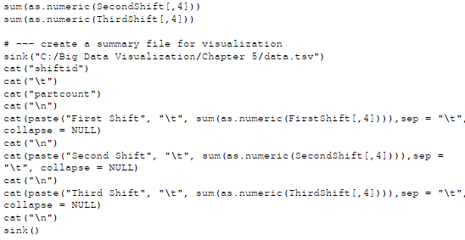
Digging deeper into the specifics of D3 use (Con..)

Slide 14
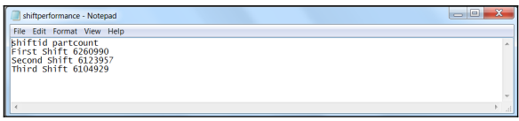
The following screenshot shows the aggregated or summary file (named data.tsv) that the R script generates:

Slide 15
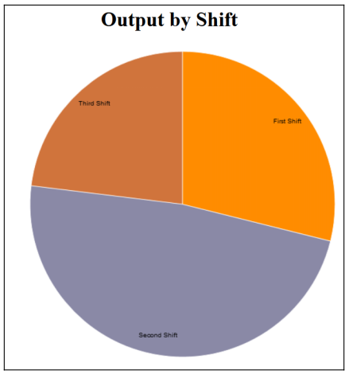
This summary file is then the source of our D3 data visualization (shown in the following figure):

Slide 16
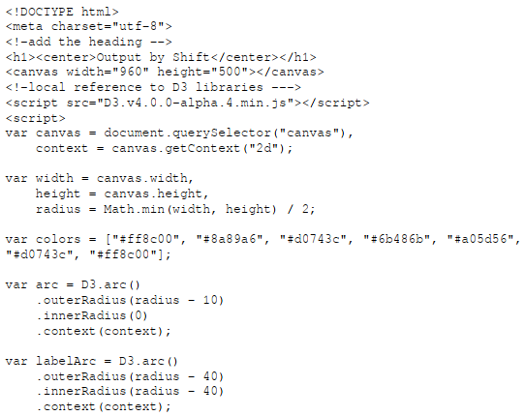
This visualization is generated using the minimalist pie chart D3-shape sample template

Slide 17
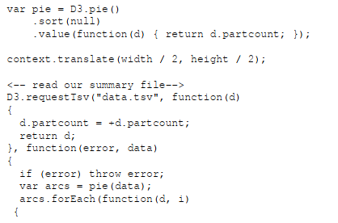
This visualization is generated using the minimalist pie chart D3-shape sample template (Con..)

Slide 18
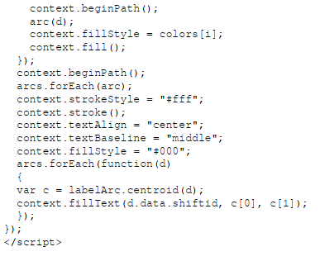
This visualization is generated using the minimalist pie chart D3-shape sample template (Con..)

Slide 19
A little Downtime The machine state is the current condition of the machine, typically running, idle, unplanned down, planned down, changeover/setup, and offline.
Searching the D3 site, we find that there is a fine stacked bar sample template that lends itself nicely to our requirements.
This visual also demonstrates the use of runtime reconfiguration in that it uses a standard HTML radio button that the user can use to switch or transition the visualization view from a stacked bar to a multiples bar display format.
The template is named Stacked-to-Multiples and it can be found at http://blocks.org/mbostock/4679202

Slide 20
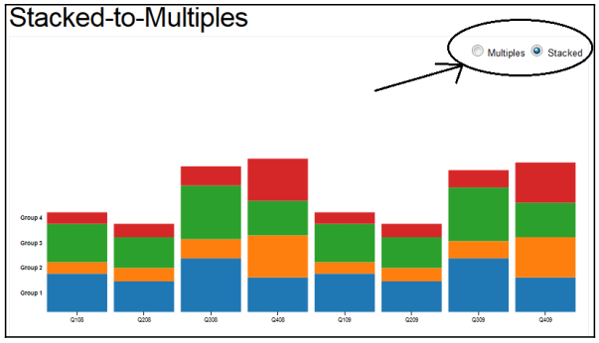
A little Downtime (Con..)

Slide 21
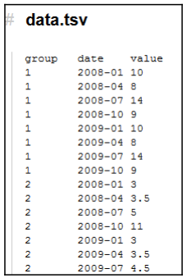
A little Downtime (Con..)
This D3 sample template uses a summarized data file to drive the visualization.
The data file (named data.tsv) contains records with three fields: group, date, and value, and it is (partially) shown in the following screenshot

Slide 22
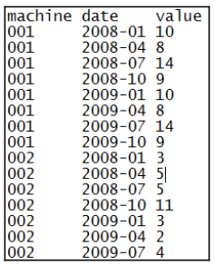
A little Downtime (Con..)
we can pre-process our raw plant data into the preceding file format–but with
one slight difference: rather than using a group field, we'll use that first field (or column) of data as our machine ID (the other two fields can remain the same).
data file as datastacked.tsv, and it is partially shown here

Slide 23
A little Downtime (Con..)
we can pre-process our raw plant data into the preceding file format–but with
one slight difference: rather than using a group field, we'll use that first field (or column) of data as our machine ID (the other two fields can remain the same).
data file as datastacked.tsv, and it is partially shown here

Slide 24
A little Downtime (Con..)
Once again, the pre-processing of the raw plant data could be accomplished using R scripts or other tools.
Big data sources would typically be (perhaps) chunked or processed in segments to effectively arrive at the desired aggregated or summarized file, ready for visualization.
The next step (in adopting this D3 sample template) is to download the sample template and save it as an HTML document. From there, we can make a few minor modifications:
As mentioned earlier in this chapter, I have downloaded and saved the D3 library files, so I need to change the src= reference within the HTML document (to make it a local reference). It should look as follows:
<script src="D3.v3.min.js"></script>
2. Since I renamed the data file, locate the line in the HTML document referencing the file name and change it to reflect our data file name: D3.tsv("datastacked.tsv", function(error, data) {

Slide 25
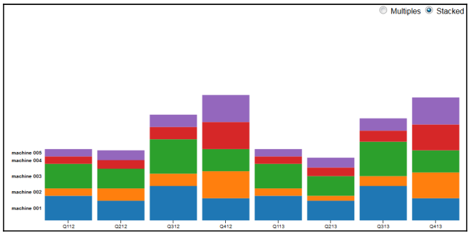
A little Downtime (Con..)
3. Finally, since we've changed the first field name in our data file (from group to machine), we need to change all references to that field within the HTML document. Hint: a simple global find and replace in a text editor does the trick!
4. Save the updated HTML file and view it in your web browser! The following figure shows our data visualization showing the stacked view

Slide 26
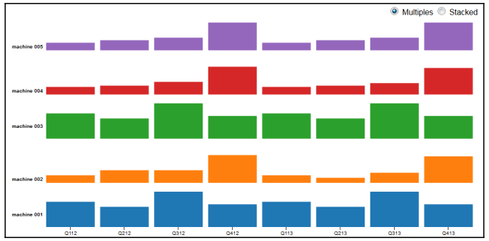
A little Downtime (Con..)
If you click on the radio button labeled Multiples, the visualization changes format:

Slide 27
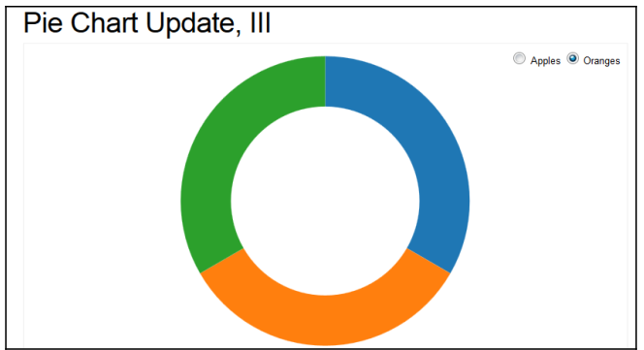
Visual transitions
The procedure of clicking on the HTML radio buttons to change the format of the visualization is known as transitioning. In the preceding example, we transitioned from
one format to another. We can also use transitioning to change what data the visualization is driven from.
This template transitions the visualization between Apples data and Oranges data:
http://blocks.org/mbostock/5681842

Slide 28
Visual transitions (Con..)
The usual steps are downloading the HTML template, locating and changing the D3 library reference, and updating the data.
Let's look at the three specific customizations:
Step1. I added a simple heading:
<center><H1>Parts by Shift</H1></center>
Step2. I changed the HTML form from apples to oranges to indicate our three plant shifts. Note that I had to add a third HTML radio button:

Slide 29
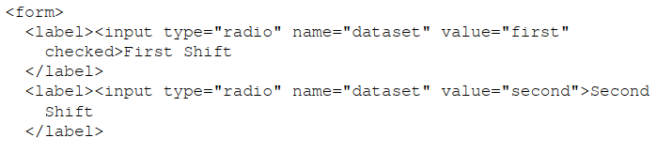
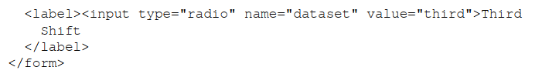
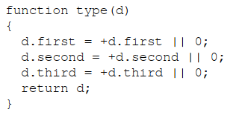
Visual transitions (Con..)
Step 3. I modified the function that handles missing data to validate all three shifts:

Slide 30
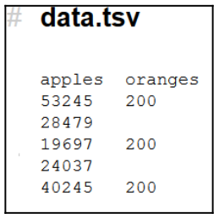
Visual transitions (Con..)
Again, notice that I simply changed the references from apples and oranges to first and second, and then added a third reference, for our third shift.
The last step is to pre-process our raw plant data into a summary file that this D3 template can use.
It is a pretty simple file, with just two fields, apples and oranges (shown in the following screenshot). You will notice that the second field (oranges) is missing values:

Slide 31
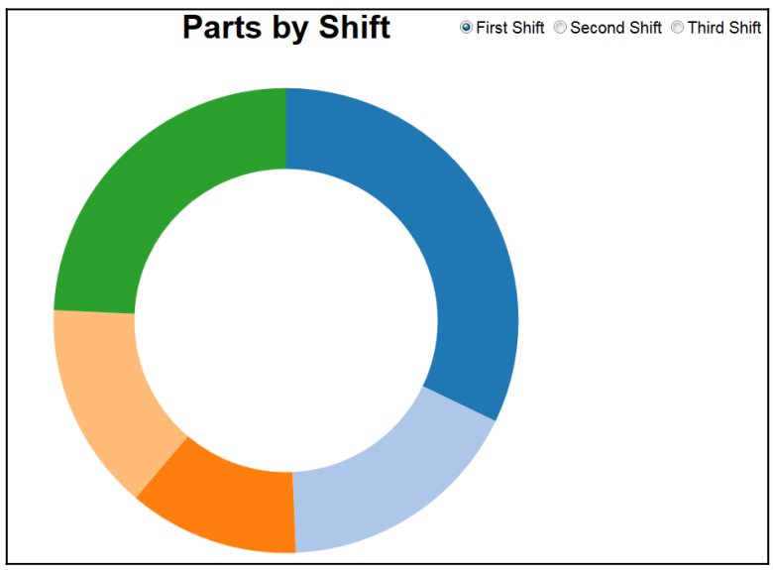
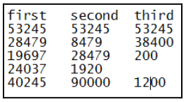
Visual transitions (Con..)
For our data, we will have three fields (one for each shift): first, second, and third. After having summarized our data, we see the following:

Slide 32
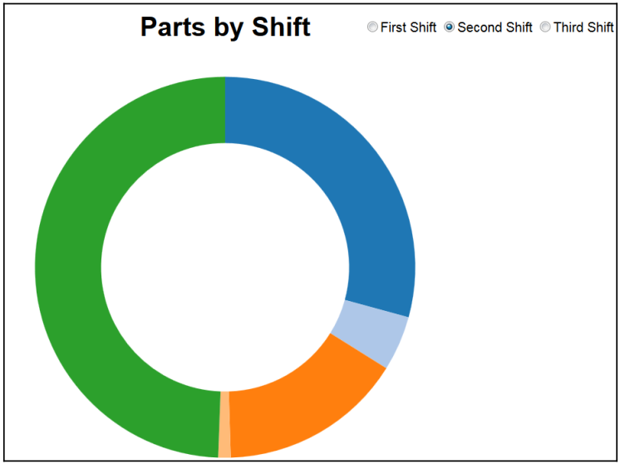
Visual transitions (Con..)
Now we see a donut pie split by machines for the first shift, but if we click on the radio button to Change the shift to Second Shift, we see the following:

Slide 33
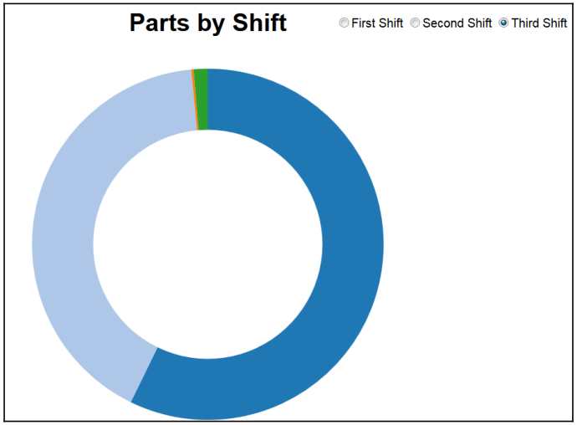
Visual transitions (Con..)
The third shift looks as follows:

Slide 34
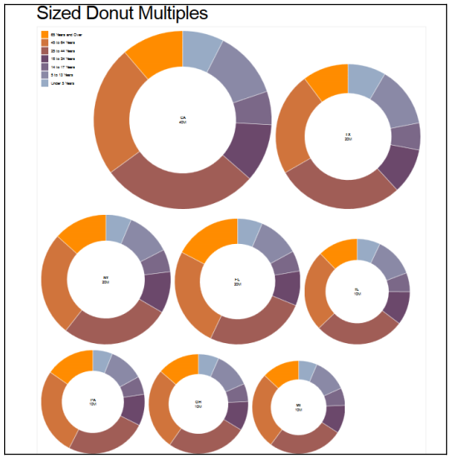
Visual transitions (Multiple donuts)
Another interesting and perhaps useful available D3 visualization sample template is the Sized Donut Multiples template. This template can be viewed and downloaded from:
http://blocks.org/mbostock/4c5fad723c87d2fd8273
Same Steps to Follows based on Previous Example.

Slide 35
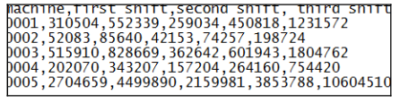
More Visualization using D3.
I've pre-processed our raw plant data again, this time creating a summary file of four columns:
Machine
First shift
Second shift
Third shift

Slide 36
More Visualization using D3 (Con..)
Using the same process to adopt the sample template that we have used for all of the examples throughout this chapter, we:
1. Download the sample template and save it as an HTML document.
2. Change the src= reference (to a local reference for the D3 libraries).
3. Change the name of the data file.
4. Add a heading.
In this example, since the D3 sample template uses the first field in the file by name (and that name is used as the visualization key), we need to again make a global change of all references to the word state to the machine.

Slide 37
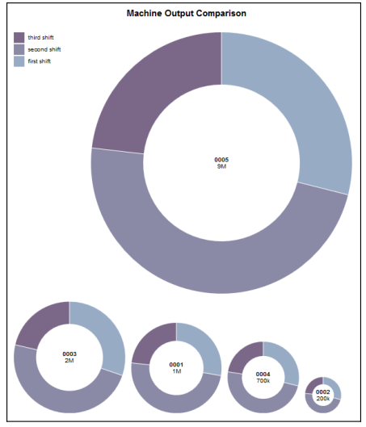

Slide 38
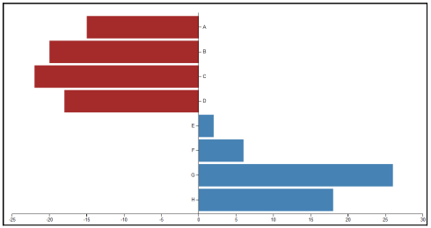
Another twist on bar chart visualizations
The D3 example named Bar Chart with Negative Values II handles this kind of scenario nicely and it can be viewed and downloaded from the following location:
http://blocks.org/mbostock/79a82f4b9bffb69d89ae.

Slide 39
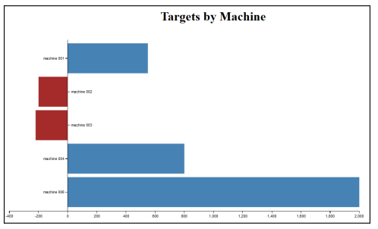
Example
The process to adopt the sample D3 template is even more straightforward:
1. Download the template and save it as an HTML document.
2. Modify the src= reference to be a local reference.
3. Add a heading.
4. Change the file name reference.
You can see from the visualization generated (shown prior) that machine 002 and machine 003 are not hitting the target, while machine 001, machine 004, and machine 005 have actually surpassed the target value. The machine 005 is actually hitting it out of the park by surpassing the target value by 2,000 parts

Slide 40
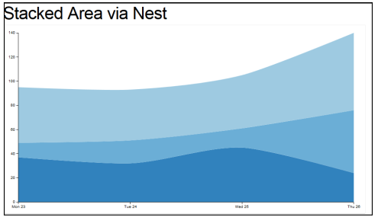
More Examples
let us now look at the D3 Stacked Area via Nest template.
This sample template creates a data visualization driven by a summary data file with three fields:
A key
A numeric value
A date (MM/DD/YY)
The following figure shows the data visualization generated by the sample D3 template:

Slide 41
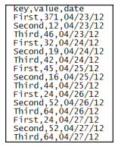
Adopting the sample
we see a file source with only three fields: a key, a numeric value, and a date
Given these assumptions, we can pre-process or summarize our raw plant data into the appropriate format:

Slide 42
Adopting the sample (Con..)
Assume here that by now (after having read through the examples in this chapter) you know that the process to adopt a selected D3 sample template is:
1. Identify the template/example that seems to fit the objectives.
2. Download the template and save it as an HTML document.
3. Make any required HTML document changes (such as src= changes, adding a heading, or changing a data file name reference).
4. Pre-process the raw big data into a summarization file formatted to fit the sample D3 requirements.
5. View the document in a web browser.

Slide 43
